Slide 1
Simulation & Modeling 2020 - 2021
Task 3

Slide 2

Inventory Problems
Order-up-to-level Problem

Slide 3
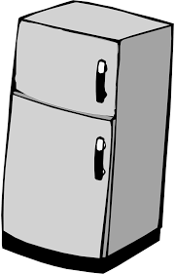
A Refrigerator Inventory Problem
A company sells refrigerators with an inventory system that:
Review the inventory situation after a fixed number of days (N) and order up to a level (M).
Order quantity = (Order-up-to level) - (Ending inventory) + (Shortage quantity)

Slide 4
A Refrigerator Inventory Problem
Random variables:
Number of refrigerators demanded each day.
Lead time: the number of days after the order is placed with the supplier before its arrival.

Slide 5
A Refrigerator Inventory Problem
If the order-up-to level (M) is 11 refrigerators, the review period (N) is 5 days , and the ending inventory on day 5 is 4 refrigerators, 7 refrigerators will be ordered from the supplier
However, if there had been a shortage of 2 refrigerators on the fifth day then 13 would have been ordered (the first two received will be provided to the customers who placed an order and were willing to wait “called backorder”)

Slide 6
Demand | Probability | Cumulative Probability | Random Digit Assignment
0 | 0.1 | 0.1 | 01-10
1 | 0.25 | 0.35 | 11-35
2 | 0.35 | 0.7 | 36-70
3 | 0.21 | 0.91 | 71-91
4 | 0.09 | 1.00 | 92-00
Figure 1 : Random Digit Assignments for Daily Demand

Slide 7
Lead Time (Days) | Probability | Cumulative Probability | Random Digit Assignment
1 | 0.6 | 0.6 | 1-6
2 | 0.3 | 0.9 | 7-9
3 | 0.1 | 1.0 | 0
Figure 2: Random Digit Assignments for Lead Time

Slide 8
A Refrigerator Inventory Problem
The Simulation is started with the inventory level at 3 refrigerators and an order for 8 refrigerators to arrive in 2 days’ time

Slide 9
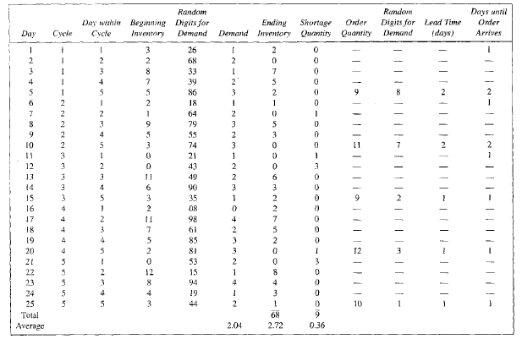
Simulation table for (M=11, N=5) inventory System
Lead time
Set dashes to zero in simulation case

Slide 10
A Refrigerator Inventory Problem
The Order for 8 refrigerators is available on the morning of the third day of the first cycle, raising the inventory level from 0 to 8 refrigerators
Demands during the remainder of the first cycle reduced the ending inventory to 2 refrigerators on the fifth day
An Order for 9 refrigerators was placed, the lead time for this order was 2 days.
The order for 9 refrigerators was added to inventory on the morning of day 3 of cycle 2.

Slide 11
System Inputs
The Order-up-to-level (M)
The Review Period (N)
The Demand probability Distribution
The Lead Time probability Distribution
Number of Days ( Stopping Condition)
Beginning Inventory Quantity
First Order arrives after ?
First Order Quantity

Slide 12
System Outputs
1- Simulation Table having the following columns
Day
Cycle
Day within cycle
Beginning Inventory
Random Digit for Demand
Demand
Ending Inventory
Shortage Quantity
Order Quantity
Random Digit for Demand
Lead Time
Days until Order arrives

Slide 13
System Outputs
2- Performance Measures
Ending Inventory Average
Shortage Quantity Average

Slide 14
Task (4) Deliverables
The complete simulation table
The performance measures window
Bonus: Reading Inputs from file

Slide 15
Task (4) Delivery Rules
Task delivery next week (starting from 16.12.2017 till 21.12.2017)
Every team should commit to their assigned time slot [same as Task(1),(2) and (3)]
Any delay will not be accepted
Cheating Policy
First Incident: -10% from the yearwork grades
Second Incident: -50% from the yearwork grades
Third Incident: -100% from the yearwork grades

Slide 16
More Notes
GUI is mandatory.
Well OOP design is mandatory.

Slide 17
Template Walkthrough

Slide 18
Using TestCases
You are given a testcase to run that will provide with a message
Success message if your code runs correctly.
Error message describing the failed part.
Running using testcases
Your system object

